Slide 1
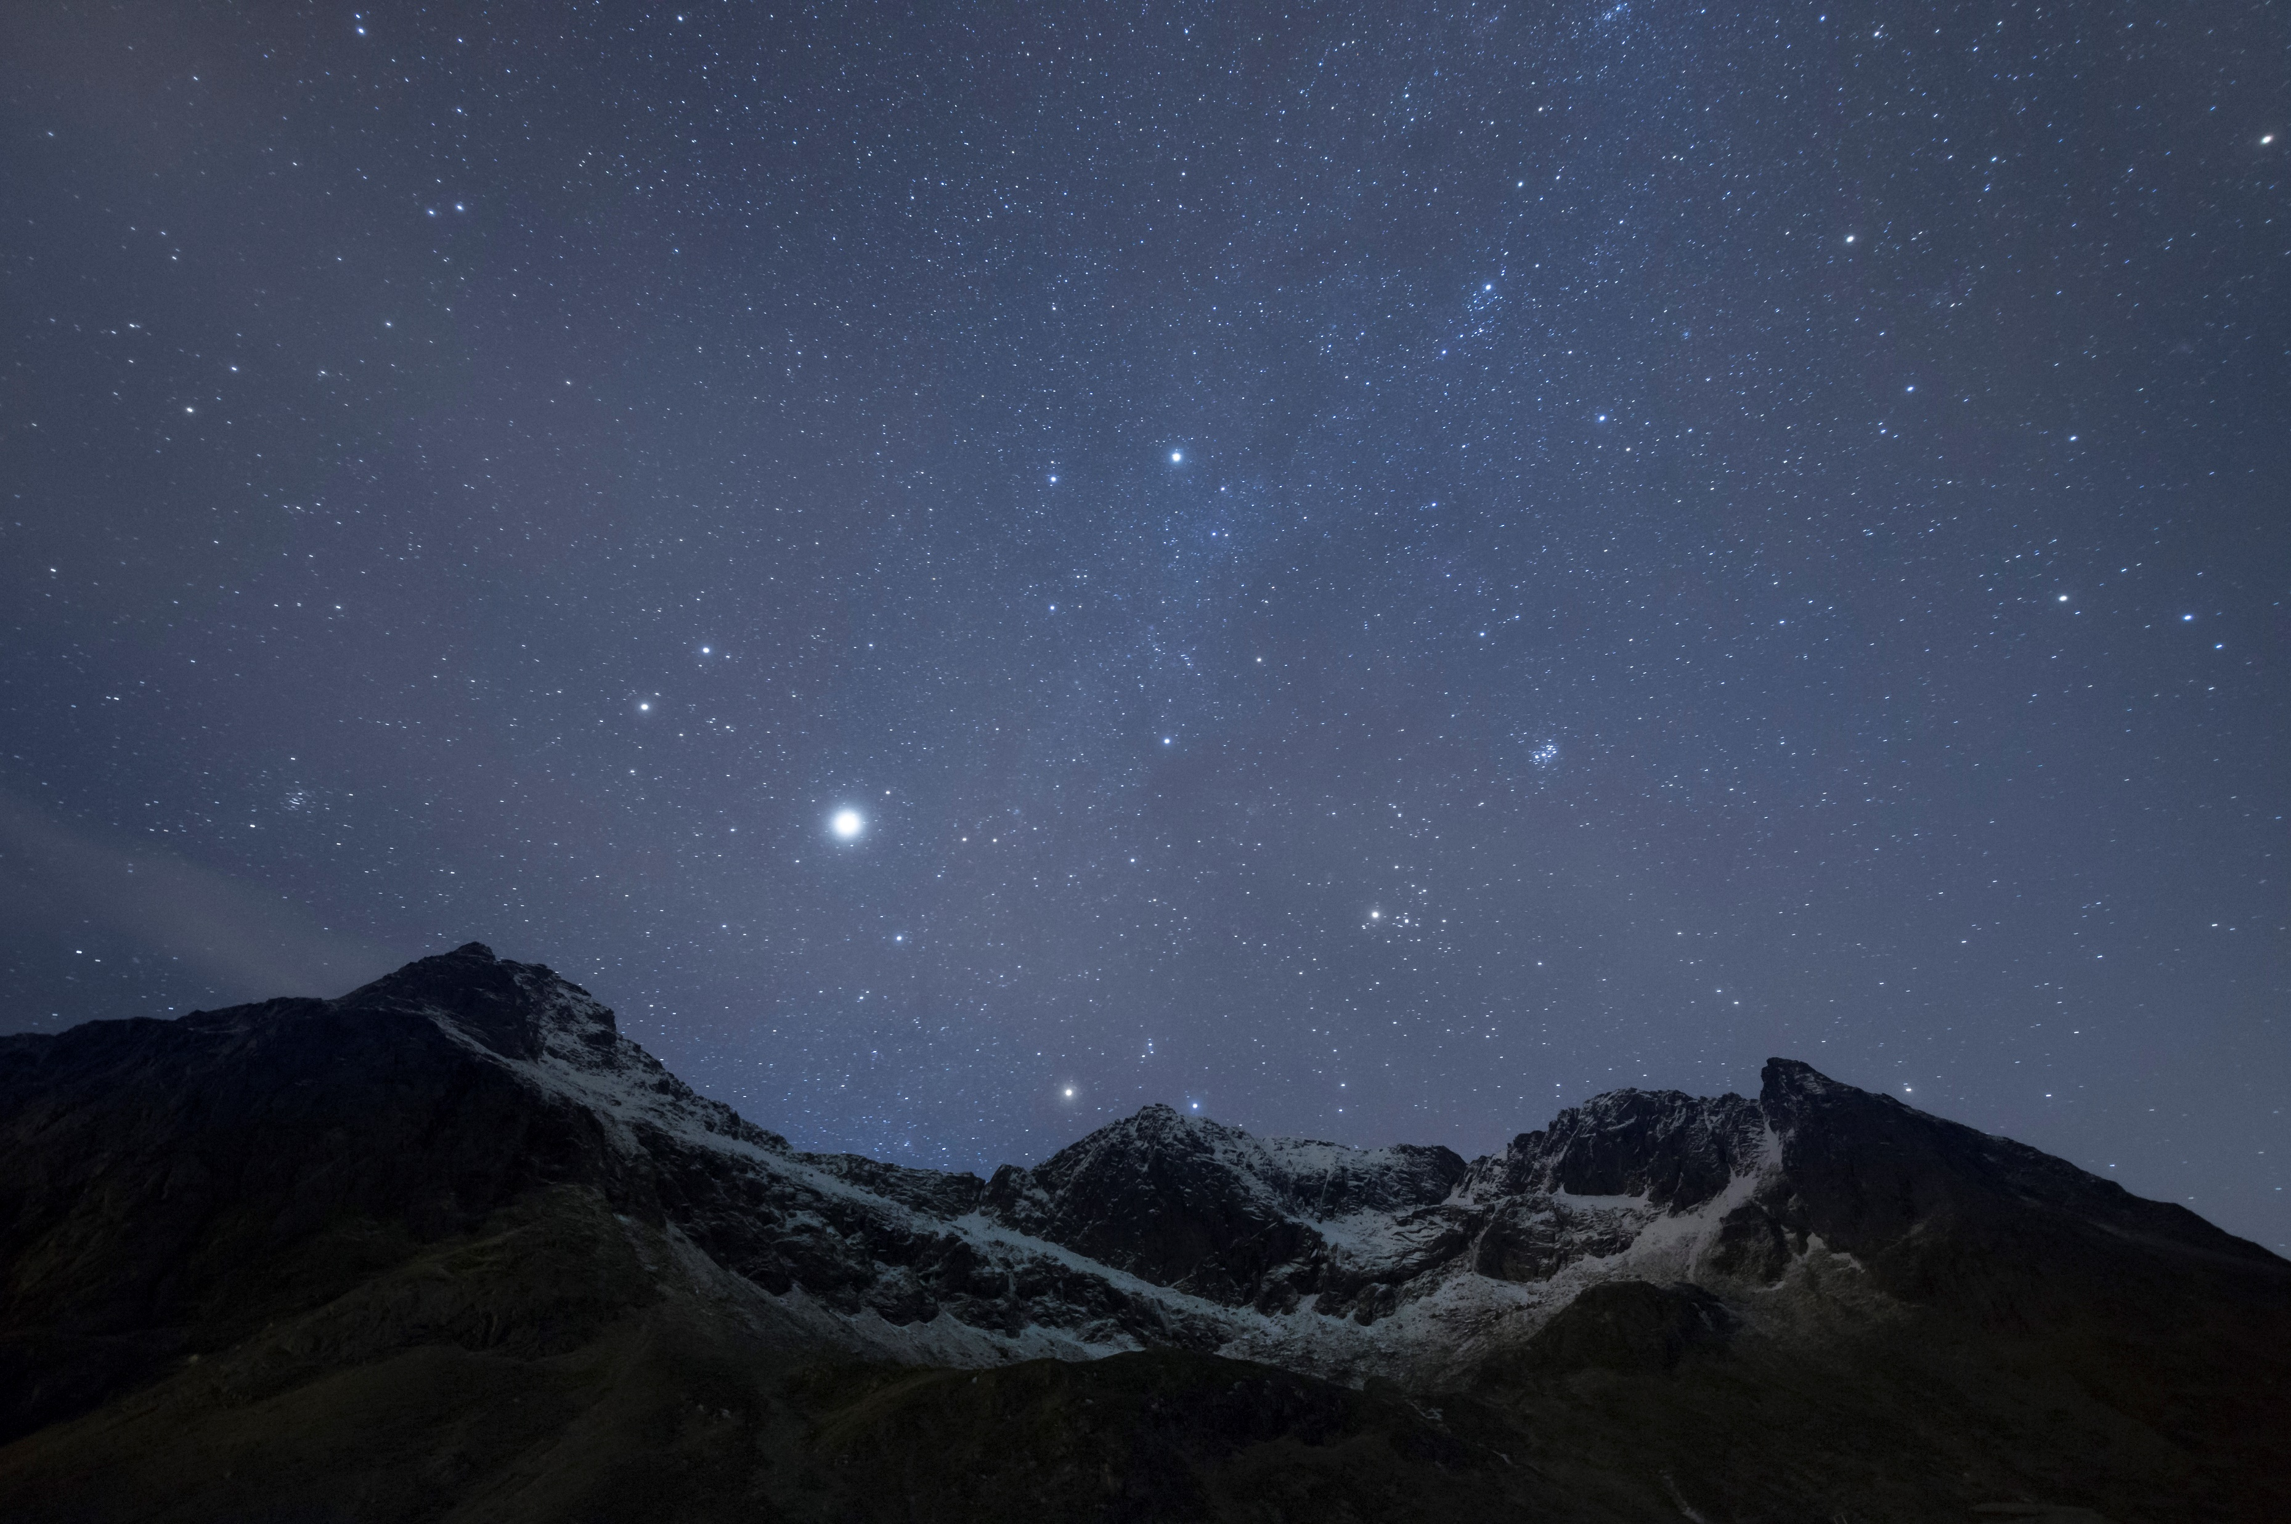
Psalm Enchanted Evening
Psalms book i

Slide 2
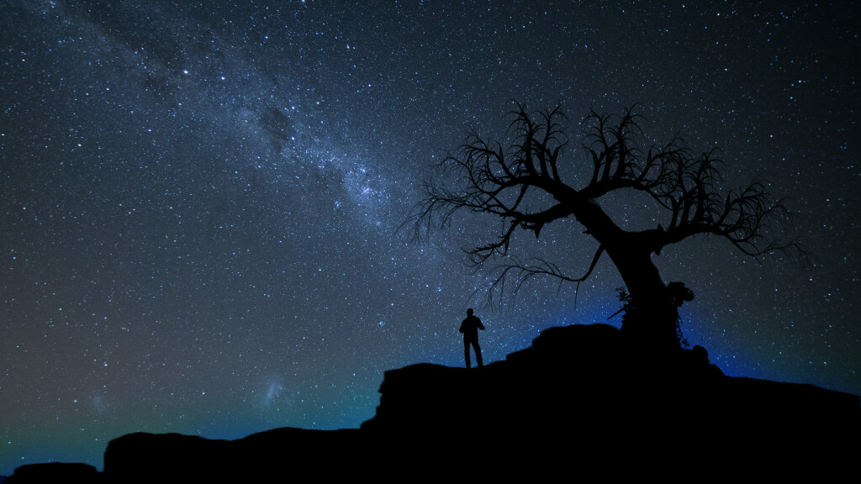
Psalm 8 When I consider the work of Your hands
What is man that Thou art mindful of him?

Slide 3
Psalm 8.3-9
When I consider (Hebrew ra’ah a verb meaning to see with the eyes) Thy heavens ……….
Awe
Majesty
Wonder
Magnificence
So, let’s consider His heavens then …………..

Slide 4
Psalm 8.3-9
When I consider Thy heavens
How do we measure distance in space?
Light years: The distance light travels in one year
Perspective: 1 light year = 9.4 trillion kilometers
Our milky way galaxy is 100,000 light years across
Too difficult to even comprehend …. Right?

Slide 5
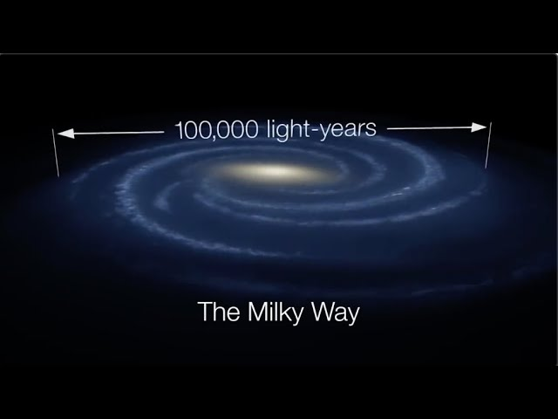
Psalm 8.3-9
When I consider Thy heavens ……….

Slide 6
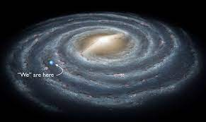
Psalm 8.3-9
When I consider Thy heavens ……….

Slide 7
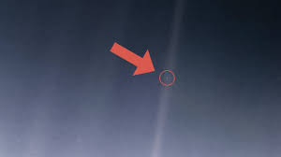
Psalm 8.3-9
When I consider Thy heavens ……….
That pale blue dot is us

Slide 8
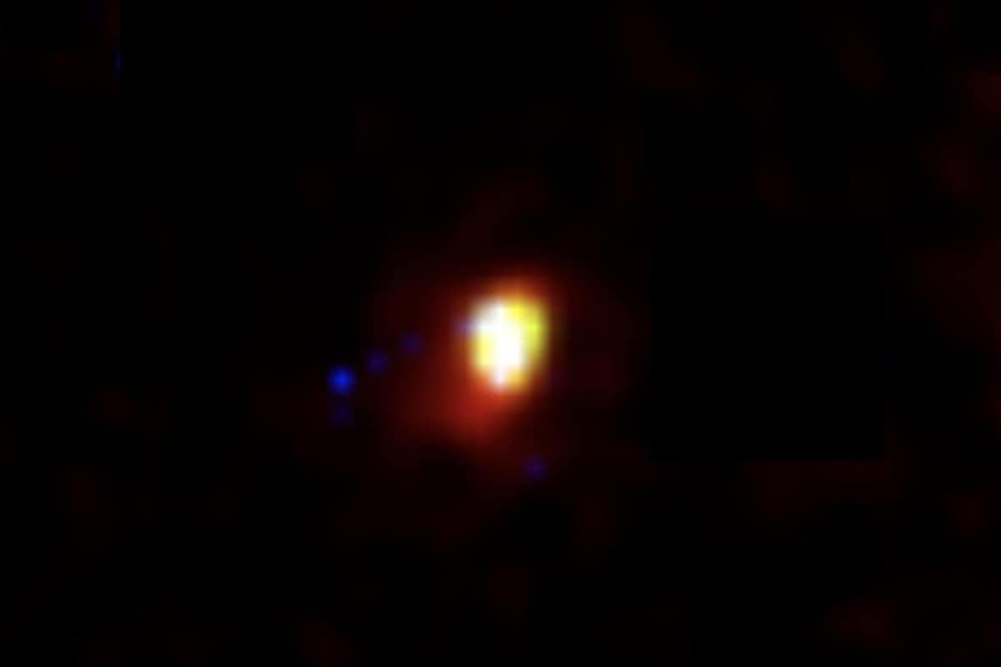
Psalm 8.3-9
When I consider Thy heavens ……….
The Farthest Galaxy From Earth
Galaxy HD1 is 35 billion light years from earth

Slide 9
Psalm 8.3-9
When I consider Thy heavens ……….
The heavens are His, by creation
The work of Thy fingers

Slide 10
Psalm 8.3-9
The moon and the stars
Which Thou hast ordained
And here we see David, the shepherd boy, only a teenager, when all is dark and quiet in the Judean hills, gazing up into the cosmos and meditating upon the One they call YHWH, the great I AM

Slide 11
Psalm 8.3-9
What is man
That Thou art mindful of him
Man? Hebrew “mah enosh” meaning what is infirm or miserable man
David is referring to man in his fallen state

Slide 12
Psalm 8.3-9
What is man
That Thou art mindful of him
Mindful? Hebrew meaning to take note or be cognizant of
The contrast is too great to comprehend

Slide 13
Psalm 8.3-9
And the son of man
That Thou visitest him
Son of man? Hebrew ben Adam, the son of Adam, the sinful son of a sinful father

Slide 14
Psalm 8.3-9
And the son of man
That Thou visitest him
Visitest? Hebrew “piqad” in this instance meaning to seek out in order to do good to

Slide 15
Psalm 8.3-9
For Thou hast made him a little lower than the angels
Angels? Spirit beings, ministering spirits in fact that have been sent forth to minister for them who shall be heirs of salvation (Heb 1.14)

Slide 16
Psalm 8.3-9
For Thou hast made him a little lower than the angels
Angels? Man has a physical body and is therefore attached to the earth, but also a spirit and an immortal soul making him a little lower than the angels

Slide 17
Psalm 8.3-9
And has crowned him with glory and honour
God has endued man with noble faculties and capabilities which have been withheld from the animal kingdom over whom God made man ruler

Slide 18
Psalm 8.3-9
Thou madest him to have dominion (Heb mashalto rule) over the works of Thy hands, Thou hast put all things under his feet
All sheep and oxen, yea, and the beasts of the field
The fowl of the air, and the fish of the sea and whatsoever passeth through the paths of the seas

Slide 19
Psalm 8.3-9
O LORD (YHWH), our Lord (Adonai) how excellent is Thy name in all the earth
….. And so, David ends as he began

Slide 20
Psalm 24 A Celebration & a Prophecy
Next time

