Slide 1
Psalm Enchanted Evening
Psalms book i

Slide 2
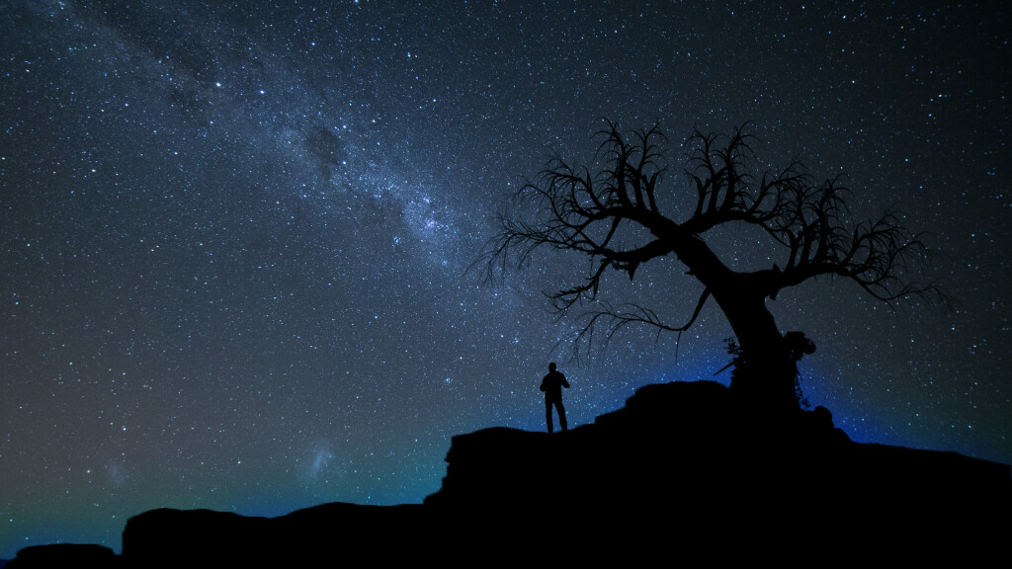
Psalm 8 When I consider the work of Your hands
What is man that Thou art mindful of him?

Slide 3
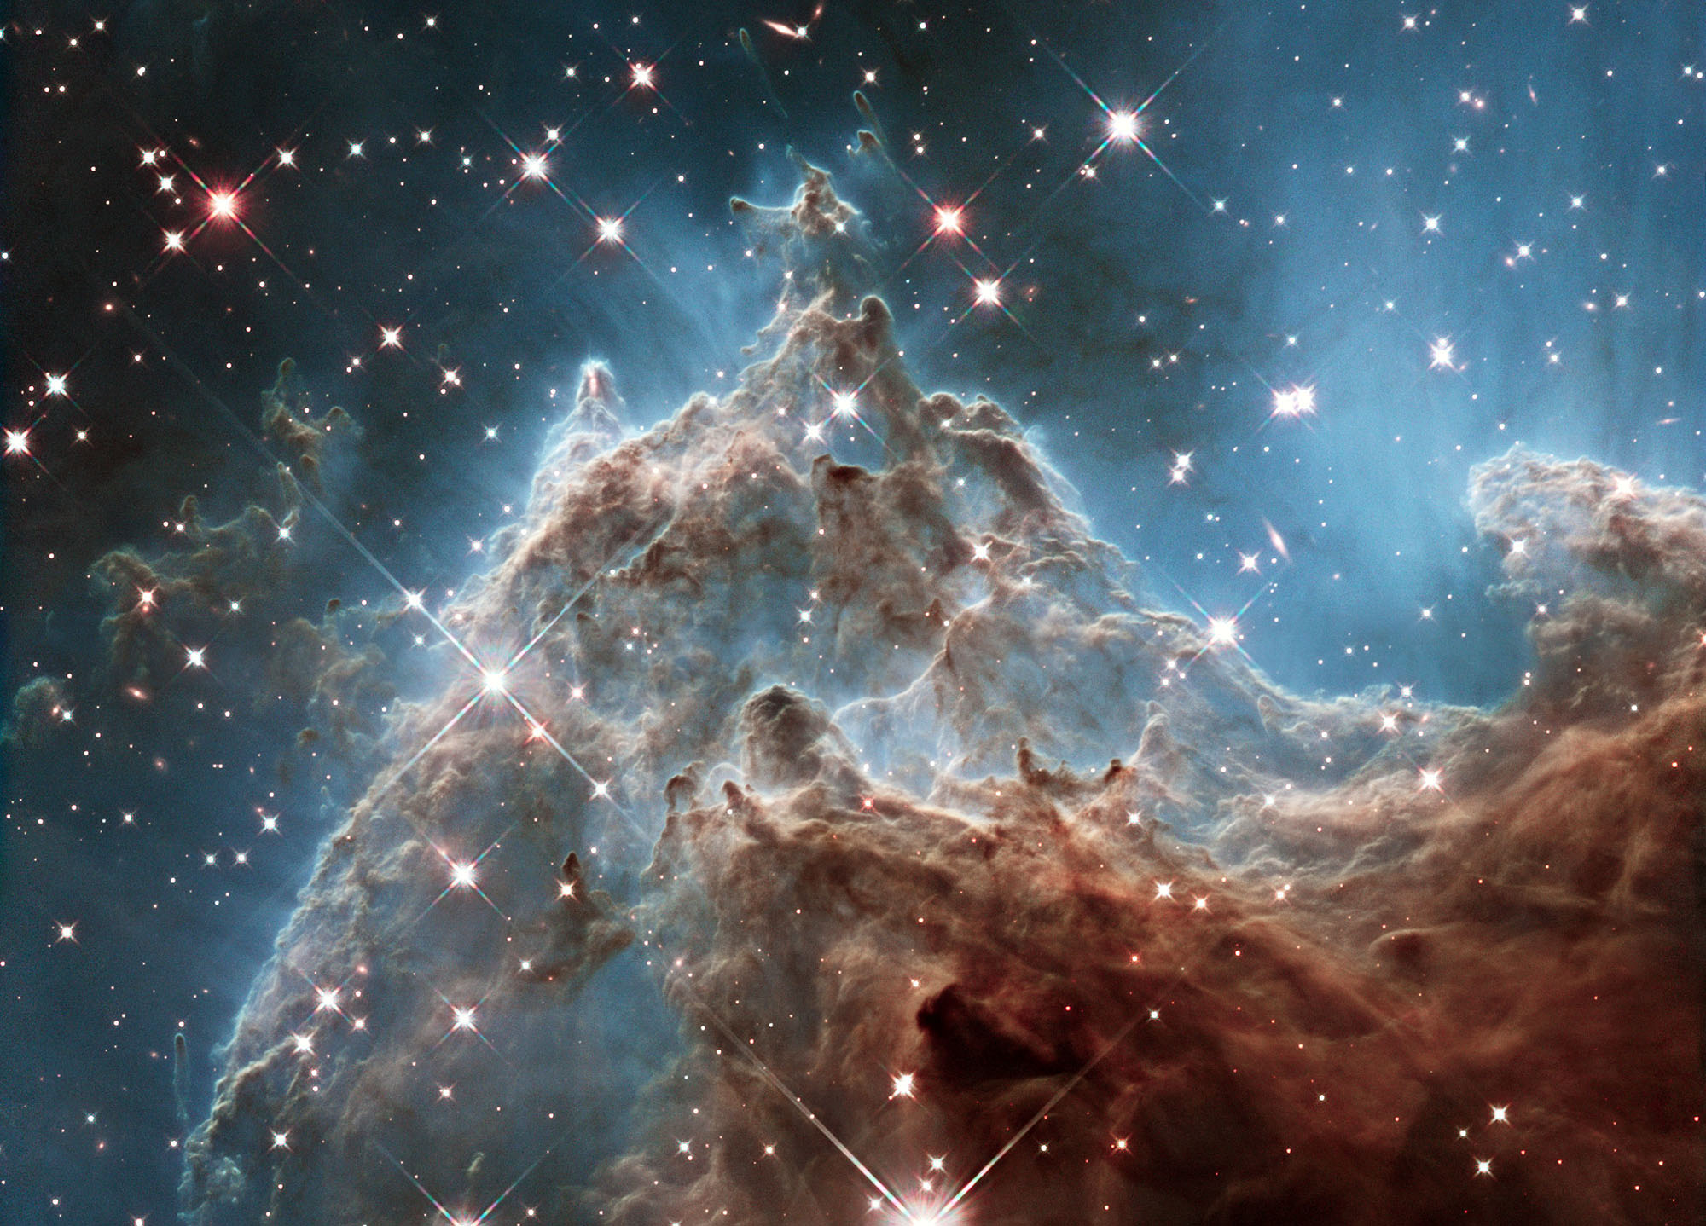
Psalm 8 When I consider the work of Your hands
What is man that Thou art mindful of him?

Slide 4
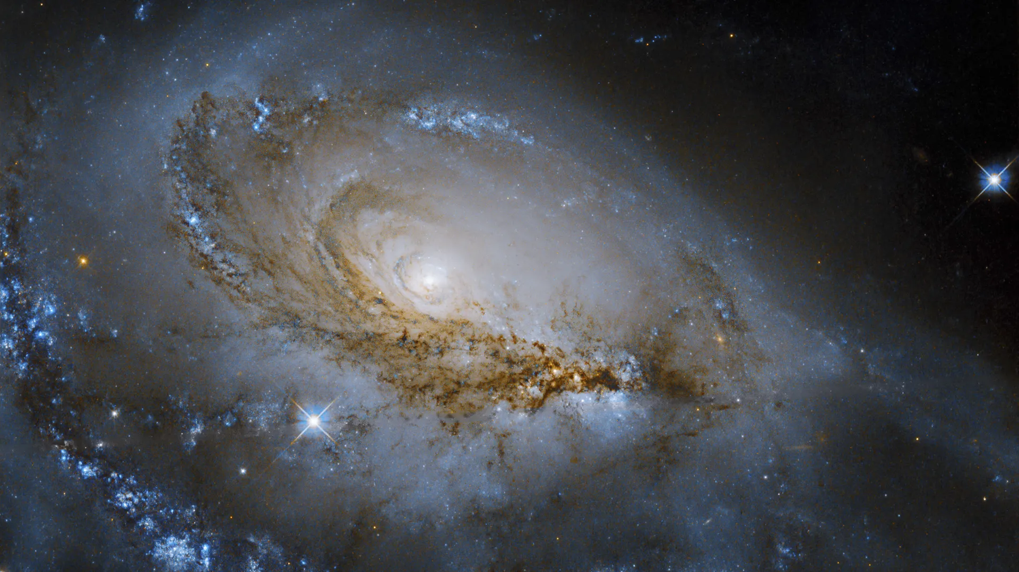
Psalm 8 When I consider the work of Your hands
What is man that Thou art mindful of him?

Slide 5
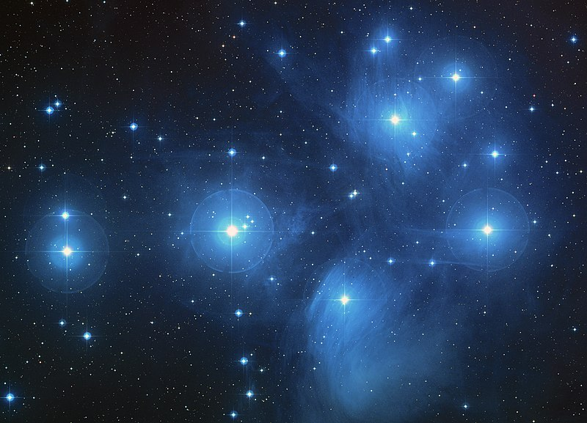
Psalm 8 When I consider the work of Your hands
What is man that Thou art mindful of him?

Slide 6
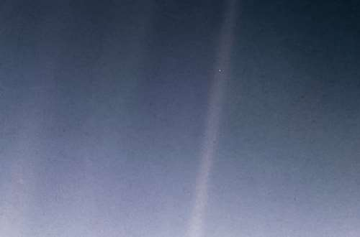
Psalm 8 When I consider the work of Your hands what is man that you are mindful of him

Slide 7
Psalm 8.1a
O LORD YHWH (Unapproachable)
Our Lord Adonai: Note the personal pronoun that makes God approachable & available because of Christ
Hebrews 4.14-16 Boldness to come before the Throne of Grace

Slide 8
Psalm 8.1a O LORD our Lord
Sh’ma Yisrael Hear O Israel
Adonai eloheinu The Lord is our God
Adonai echad The Lord is one

Slide 9
Psalm 8.1 b How excellent is Your name in all the earth
Excellent (Heb: Addiyr)
Powerful, famous, gallant, glorious, goodly, lordly, mighty, noble, worthy, principal
When used of God, it’s emphasis is on His majestic power (Isaiah 10.34) greater than the mighty waves of the sea (Ps 93.4)

Slide 10
Psalm 8.1 c Who has set Thy glory above the heavens
Speaking of His Son, the Lord Jesus Christ and the brightness of his glory;
In whom is all the fulness of the Godhead, the glory of all the divine perfections; (Psalm 63.2)
As He has been set above the heavens, exalted at the right hand of God; where angels, principalities, and powers became subject to him, and he was made higher than the heavens (Hebrews 7.26)

Slide 11
Psalm 8.1 c Who has set Thy glory above the heavens
Above the heavens
Meaning the visible heavens
Firstly, earth's atmosphere
Secondly, where the stars and planets are
Thirdly, where God’s Throne is

Slide 12
Psalm 8.2 Out of the mouth of babes and sucklings
What is a “babe” and what is a “suckling”
Babe comes from a Hebrew word meaning infant
Various anthropological studies have shown that a suckling can be a child up to the age of 6 years and this is supported by ancient Jewish religious texts

Slide 13
Psalm 8.2 Out of the mouth of babes and sucklings
Sarah was 99 years old when Yitzhak (Isaac) was born
Sarah breastfed him to indicate to the wider Jewish community that she was in fact the birth mother

Slide 14
Psalm 8.2 Out of the mouth of babes and sucklings
There are clear religious roots to breastfeeding in ancient Israel, as well as a number of references in religious texts.
It is also part of cultural tradition as breastfeeding was considered to be an obligation and a joy

Slide 15
Psalm 8.2 Out of the mouth of babes and sucklings
There is a fantastic description in the Gemara (Jewish commentaries on the Mishna) of the people of Israel, men and women, reciting the “Song of the Sea” after the amazing miracle of the splitting of the Red Sea.
The Gemara says: “How did they recite the “Song of the Sea”?

Slide 16
Psalm 8.2 Out of the mouth of babes and sucklings
The baby was placed on the knees of his mother and nursed from her breasts. When they saw the Shekinah, the baby lifted his head, detached from his mother’s nipple, and said:
‘This is my God and I will adore Him, as it says:
“From the mouth of babies and infants you have become fortified with strength”

Slide 17
Psalm 8.2 Thou has ordained strength
Ordained: From the Hebrew word “Yasad” meaning to lay a foundation
Strength: The Hebrew word for “strength” can refer to boldness, might, power, strength, security, majesty, and praise

Slide 18
Psalm 8.2 Thou has ordained strength
Jesus Matthew 21.12-17
21.12 And Jesus went into the temple of God, and cast out all them that sold and bought in the temple, and overthrew the tables of the moneychangers, and the seats of them that sold doves

Slide 19
Psalm 8.2 Thou has ordained strength
Jesus Matthew 21.12-17
21.13 and said unto them: It is written, my house shall be called the house of prayer, but you have made it a den of thieves

Slide 20
Psalm 8.2 Thou has ordained strength
Jesus Matthew 21.12-17
21.14 and the blind and the lame came to Him in the temple; and He healed them
Out they went, money changers and dove sellers alike, scorned by the Messiah ……….. and in they came, the blind and the lame and He had compassion on them and healed them all

Slide 21
Psalm 8.2 Thou has ordained strength
Jesus Matthew 21.12-17
21.15 and when the chief priests and scribes saw the wonderful things that He did, and the children crying in the temple, and saying, Hosanna to the Son of David; they were sore displeased
The numb skulls were irritated, angry and indignant, but the young children recognised His miracles and cried out “Please save us now” (Hosanna)

Slide 22
Psalm 8.2 Thou has ordained strength
Jesus Matthew 21.12-17
21.16 and said unto Him, hearest Thou what these say? And Jesus saith unto them, yea, have you never read out of the mouths of babes and sucklings thou has perfected praise
Why did Jesus stop there and not quote the
remainder of Psalm 8.2?

Slide 23
Psalm 8.2 Thou has ordained strength
Jesus Matthew 21.12-17
21.17 and he left them, and went out of the city unto Bethany, and he lodged there
He need not quote it as the numb skulls stood there in silence with their mouths hanging open as object lesson of the last part of Psalm 8.2 and Jesus just walked away

Slide 24
More of Psalm 8 God’s Glory & Man’s Honour
Next time

