Slide 1
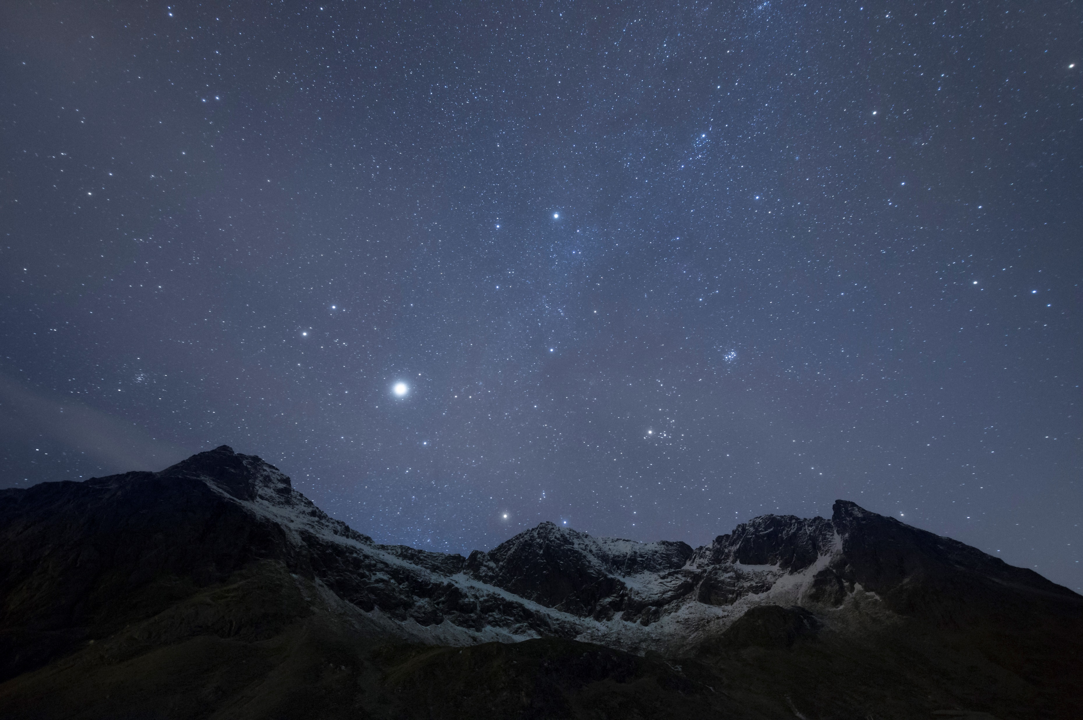
Psalm Enchanted Evening
Psalms book i

Slide 2
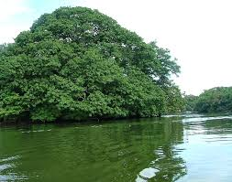
Psalm 1: Two Men, Two Ways, Two Destinies

Slide 3
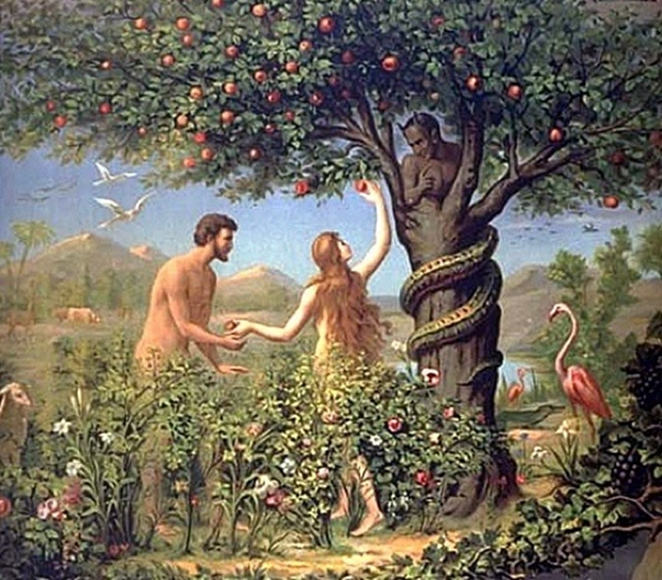
Psalm 1

Slide 4
More On Psalm 1
Walking …….
Standing …….
Sitting ……..
Note the progression downwards

Slide 5
That walketh not in the way of the ungodly
Wicked is probably the better translation
Restless, wanting in self-control, victims of ungoverned passion
But the wicked are like the troubled sea, when it cannot rest, whose waters cast up mire and dirt
Isaiah 57.20

Slide 6
Nor standeth in the way of sinners
Sinners: Overarching term for wrong doers
Romans 3.23: For all have sinned and come short of the glory of God
An archery term meaning to miss the mark

Slide 7
Nor sitteth in the seat of the scornful
Scornful
Joining those in assembly who choose to mock, sneer and contemptuously deride the things of God
Atheists who arrogantly proclaim there is no God
“The fool has said in his heart there is no God”
Psalm 14.1

Slide 8
But his delight
Is the Law of the Lord
In which he meditates day and night
Meditation is deep contemplation, turning God's truth over and around in the mind to gain greater understanding and be thereby transformed
Meditation is not passive but active, engaging

Slide 9
But his delight
Is the Law of the Lord
In which he meditates day and night
Meditation is that vehicle which transports us from biblical knowledge to wisdom
Wisdom is the application of knowledge, that when applied, leads to a transformed life

Slide 10
The tree metaphor of the blessed man
And he shall be like a tree planted by the rivers of water
That bringeth forth his fruit in his season, his leaf also shall not wither, and whatsoever he doeth shall prosper

Slide 11
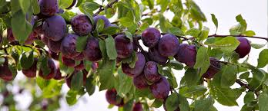
The tree metaphor of the blessed man
That bringeth forth his fruit in his season, his leaf also shall not wither, and whatsoever he doeth shall prosper

Slide 12
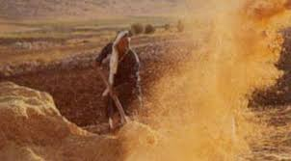
The lot of the wicked
The wicked are not so, but are like the chaff which the wind driveth away

Slide 13
The chaff metaphor of the wicked
Therefore, the wicked shall not stand in the judgement, nor sinners in the congregation of the righteous
When God judges the righteous they will "stand" in His presence (I Corinthians 3.11-15)

Slide 14
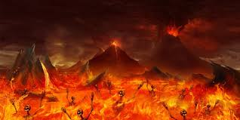
The chaff metaphor of the wicked
Therefore, the wicked shall not stand in the judgement, nor sinners in the congregation of the righteous
When God judges the wicked, they will not be able to stand in His presence and thus they will be sentenced to eternal punishment
Revelation 20.11-15

Slide 15
The omniscience of God
The Lord knoweth the way of the righteous: but the way of the ungodly shall perish

Slide 16
Psalm 8 What is man that Thou art mindful of him
Next time

