Slide 1
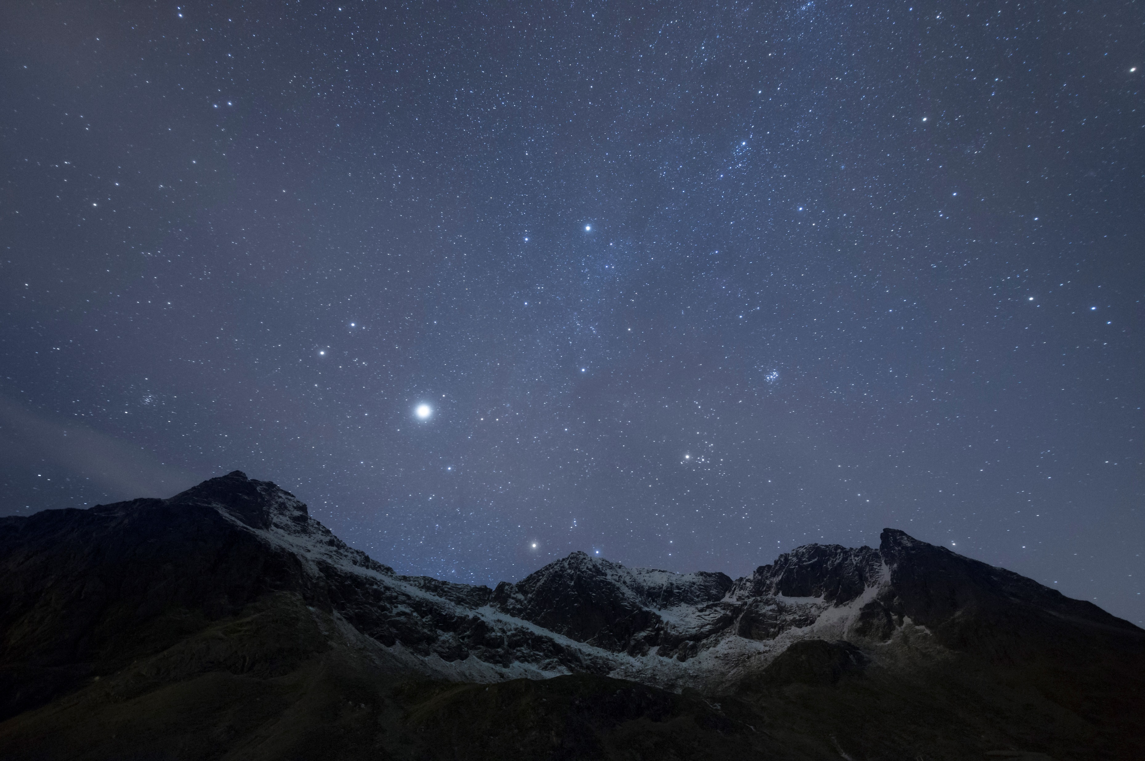
Psalm Enchanted Evening
Speaking with god in the language of the psalms

Slide 2
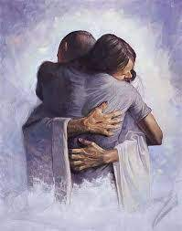
Speaking to God in the Language of the Psalms: Getting a Hug from God

Slide 3
Inspiration from Max Lucado
Don’t just read the prayers of these saints, pray them. Experience their energy. Imitate their honesty. Enjoy their creativity. Let these souls lead you in worship.
The language of worship is not polished, perfect, or advanced; It’s just honest

Slide 4
The Supreme Reverence for the Word of God in the Psalms
The Declaration of Psalm 138.2
I will worship toward thy holy temple and praise thy name for thy lovingkindness and for thy truth: For thou hast magnified thy word above all thy name

Slide 5
The Psalms & the Believer of Today
In the psalms, God has given us a new vocabulary of words to use as we speak to Him
We look to the Psalms to enable us to express ourselves to God in every situation of life

Slide 6
The Psalms & the Believer of Today
The Psalms also provide us with a template of prayer language as we meditate on each verse and turn that verse into our own intimate prayer to God

Slide 7
The Psalms & the Believer of Today
Principle 1
God’s attitude towards His Word is expressed in Psalm 138.2
“For Thou has magnified Thy Word above all Thy name”

Slide 8
The Psalms & the Believer of Today
Principle 2
The Psalms are literally the collected prayers of the authors, inspired by the Holy Spirit and included in the canon of scripture

Slide 9
The Psalms & the Believer of Today
Principle 3
Take each verse, identify what truth, desire, fear, frustration et al is being expressed and in what context

Slide 10
The Psalms & the Believer of Today
Principle 4
Now write under the bible verse in your praise and worship journal the elements of this verse that the Holy Spirit expresses to your heart as you meditate upon it

Slide 11
The Psalms & the Believer of Today
Principle 5
In formulating a prayer from a verse in the psalms, you may:
Personalize the same language used
Embed the desire of your heart into language that reflects the truth of the verse being meditated upon

Slide 12
The Psalms & the Believer of Today
Principle 6
Options:
You may work on a complete psalm and formulate a prayer to reflect the truth of each verse
Alternately, you may pause at a verse as you are reading the psalm and pray

Slide 13
The Psalms & the Believer of Today
Principles 1-6
These 6 principles will honour God as you honour His Word by seeking to express their truth in your own prayer to God

Slide 14
The Psalms & the Believer of Today
Example 1 Psalm 34.1
Scripture: I will bless the Lord at all times: His praise shall continually be in my mouth

Slide 15
The Psalms & the Believer of Today
Example 1 Psalm 34.1
My Prayer: I will bless You Lord at all times: Your praise shall continually be in my mouth
Note the personalisation of the language used

Slide 16
The Psalms & the Believer of Today
Example 2 Psalm 34.2
Scripture: My soul shall make her boast in the Lord: the humble shall hear thereof and be glad

Slide 17
The Psalms & the Believer of Today
Example 2 Psalm 34.2
My Prayer: My soul shall boast only in You Lord: I will humble myself in order to hear from You and hearing from You will make me glad

Slide 18
The Psalms & the Believer of Today
Example 3 Psalm 34.5
Scripture: They looked unto Him and were lightened; and their faces were not ashamed

Slide 19
The Psalms & the Believer of Today
Example 3 Psalm 34.5
My Prayer: When I look unto You Lord I find relief and comfort and I am not ashamed of who I am

Slide 20
The Psalms & the Believer of Today
Example 4 Psalm 34.6
Scripture: This poor man cried and the Lord heard and saved him out of all his troubles

Slide 21
The Psalms & the Believer of Today
Example 4 Psalm 34.6
My Prayer: Lord I have cried out to You so many times, and You have heard me and saved me from all my troubles. I cry out to You again in this season Lord and look with expectation for Your deliverance

Slide 22
The Psalms & the Believer of Today
Example 5 Psalm 34.11
Scripture: Come ye children, hearken unto me: I will teach you the fear of the Lord

Slide 23
The Psalms & the Believer of Today
Example 5 Psalm 34.11
My Prayer: Lord, make me to be a person who You can trust to teach others how and why to honour, exalt, praise and worship You as they hold You in reverential awe

Slide 24
The Psalms & the Believer of Today
Example 6 Psalm 34.16-17
Scripture: The face of the Lord is against them that do evil, to cut off the remembrance of them from the earth. The righteous cry and the Lord heareth and delivereth them from all their troubles

Slide 25
The Psalms & the Believer of Today
Example 6 Psalm 34.16-17
My Prayer: Lord, Your face is indeed against them that do evil and You will cut them off from the face of the earth but in all this, because I have been made righteous by the blood of Yeshua when I cry out to You I will be heard and delivered from all my troubles

Slide 26
Psalm 1: Two Men, Two Ways, Two Destinies
Next time

